Slide 1
AppDynamics Engineer Training Chapter 7 – App Infrastructure Discovery Java Tom Rabaut Sales Engineer, Manger

Slide 2



Agenda
Logical Model
Configuring Java Agents
Application Flow Map
Notes:
.NET agent configuration covers several aspects which include use of automatic and manual mode, configuring monitoring of windows service, etc.
From the dashboard perspective it is important to understand the tier/node structure and the data linked to those, as well as IIS AppPool view which explains the mapping between the IIS applications and AppDynamics nodes.

Slide 3
Logical Model
Business Application
All components or modules in an application that represent a complete set of functionality
Tiers
A module/service of the Application
Often a group of App Servers
Nodes
Single unit of processing (JVM/CLR)
One App Server Agent/Application Server

Slide 4
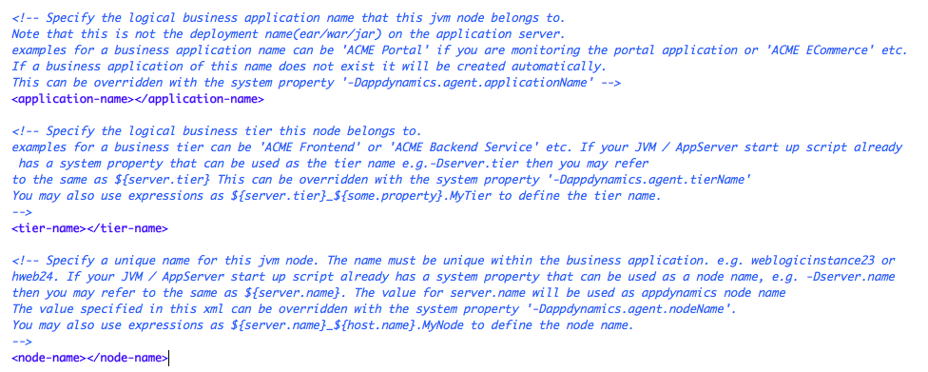
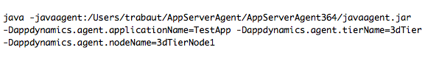
Configuring Logical Model for Java Agents
Three options for configuring the Logical Model:
Configuration file: controller-info.xml
Found in the <agent-install-dir>/conf/
Three Properties: application-name, tier-name, node-name
Java System Properties:
JVM Startup Script Options
Three Properties:
-Dappdynamics.agent.applicationName
-Dappdynamics.agent.tierName
-Dappdynamics.agent.nodeName
Automatic Naming
uniqueID argument for the Java Agent

Slide 5
Best Practices
Configure settings that are common using the controller-info.xml file
For example: Application Name
Configure settings that are unique using the JVM system properties
For example: Tier and Node Names
Do not use the same node name for nodes in different tiers. Node names must be unique across the Application

Slide 6
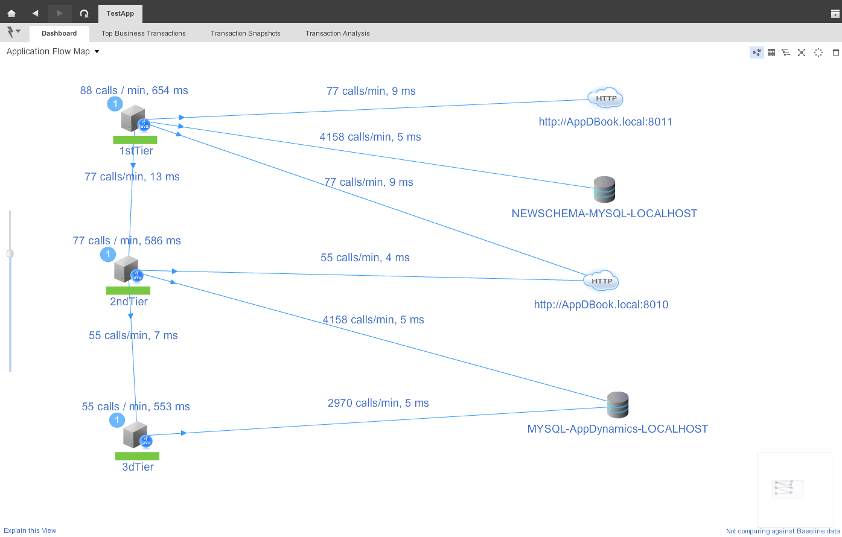
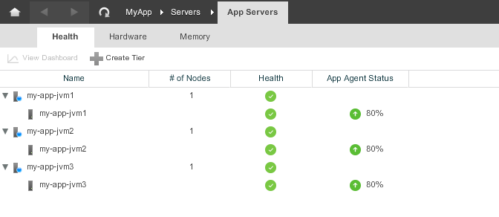
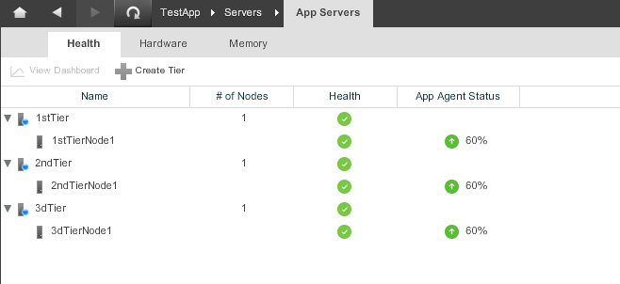
Application Flow Map
Auto-Naming

Slide 7
Thank You

